Slide 1
Big Mountain Resort executive presentation
Presenter: Weina ke
Date: 01-01-2023

Slide 2
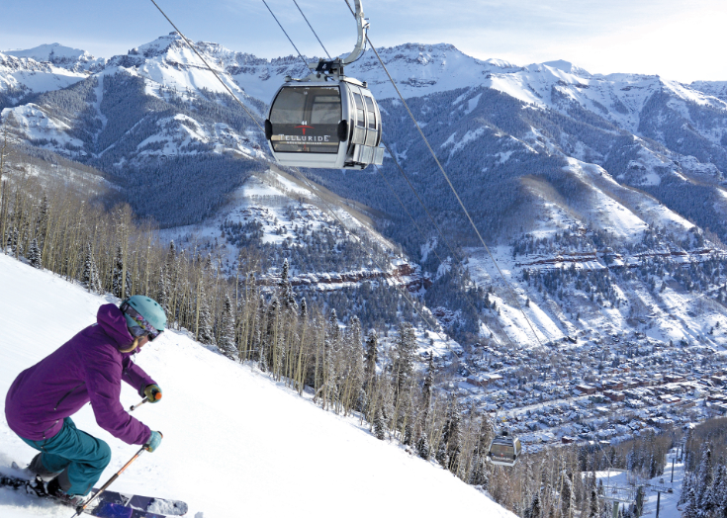
Introduction
Big Mountain Resort is a ski resort located in Montana. Big Mountain Resort offers spectacular views of Glacier National Park and Flathead National Forest, with access to 105 trails. Every year about 350,000 people ski or snowboard at Big Mountain. This mountain can accommodate skiers and riders of all levels and abilities.
Big Mountain Resort has recently installed an additional chair lift to help increase the distribution of visitors across the mountain. This additional chair increases their operating costs by $1,540,000 this season.
The resort's pricing strategy has been to charge a premium above the average price of resorts in its market segment. The business wants some guidance on how to select a better value for their ticket price. They are also considering a number of changes that they hope will either cut costs without undermining the ticket price or will support an even higher ticket price.

Slide 3
Problem identification
Problem Statement Worksheet: How should Big Mountain Resort selects a better price strategy in order to offset the additional operating costs of $1,540,000 for this season?
Context: Big Mountain Resort is a ski resort offering spectacular views of Glacier National Park and Flathead National Forest, with access to 105 trails. Because Big Mountain Resort has recently installed an additional chair, their operating costs increased by $1,540,000 this season. In response to this extra cost, a better pricing strategy must be made in order to increase revenue for the resort for this season.
Criteria for success: Success for this project = aligning on a detailed rollout map to make a better pricing strategy to achieve an increase revenue of $1,540,000 for Black Mountain Resort this season.
Scope of solution space: Data from other ski resorts with similar operation conditions.

Slide 4
Problem identification
Constraints within solution apace:
Cannot find ski resorts with similar operation conditions.
Missing key data, such as other resorts’ revenues.
Difficult in acquire key data. e.g. other resorts refuse to disclose their revenue.
Stakeholders to provide key insight:
Jimmy Blackburn, Director of Operations;
Alesha Eisen, Database Manager.
Key data sources:
Ski resorts with similar operation conditions as the Black Mountain Resort.
Revenues from these ski resorts.
The amount of people visited at these ski resorts on weekdays and weekends.
Cost (operational, maintenance, etc.) from these ski resorts.

Slide 5
Recommendations and key findings
This project aims to build a predictive model for ticket price based on a number of facilities, or properties, boasted by resorts. So there are a few recommendations :
predicting the adult weekend ticket price as the primary aim.
discarding records with missing price data after making the most of the other available data to look for any patterns between the states.
impute missing values with the mean.
assessing performance using cross-validation.
hyperparameter search using GridSearchCV.

Slide 6
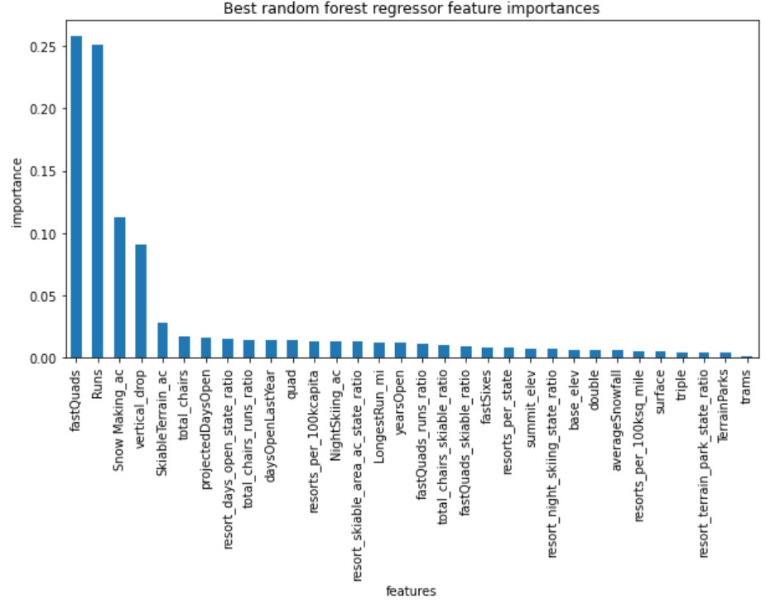
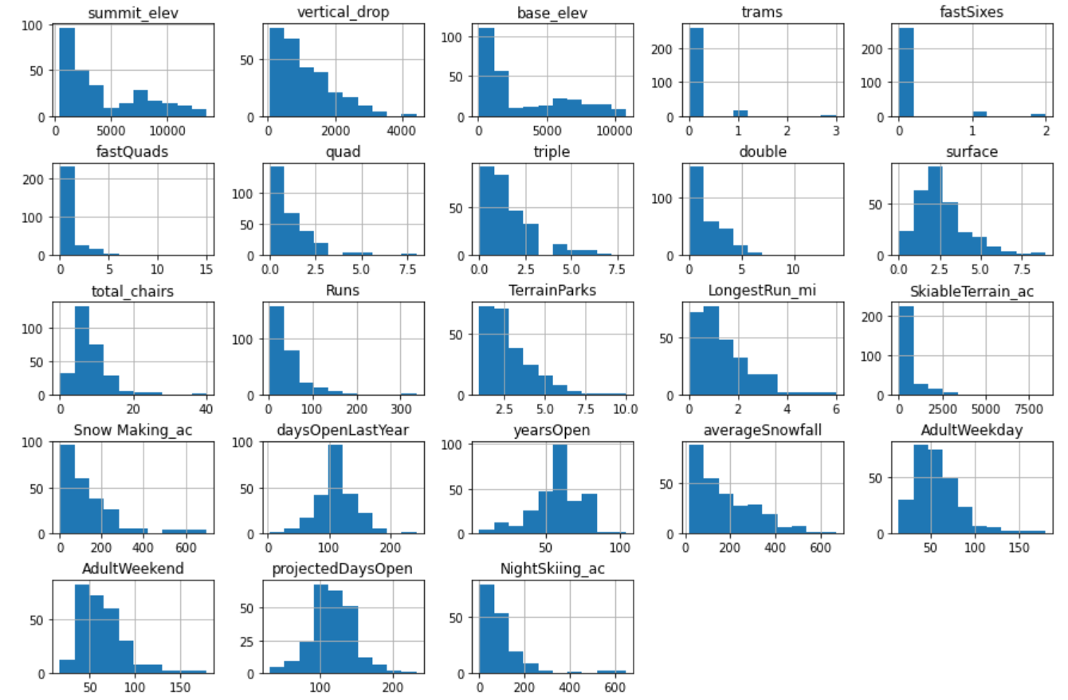
Recommendations and key findings
Some key findings:
dominant top four features: fastQuads, Runs, Snow Making_ac, vertical_drop.
The random forest model has a lower cross-validation mean absolute error, and exhibits less variability-use this model.
Drop Rows With No Price Data

Slide 7
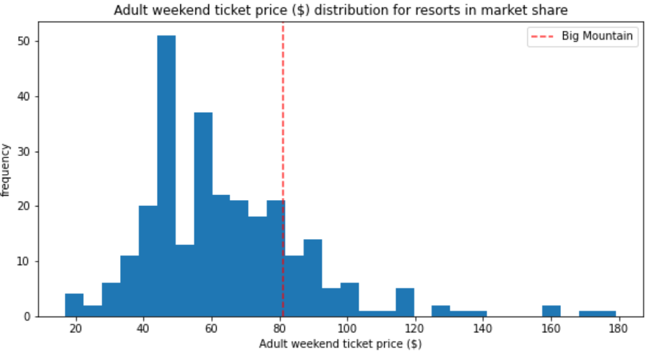
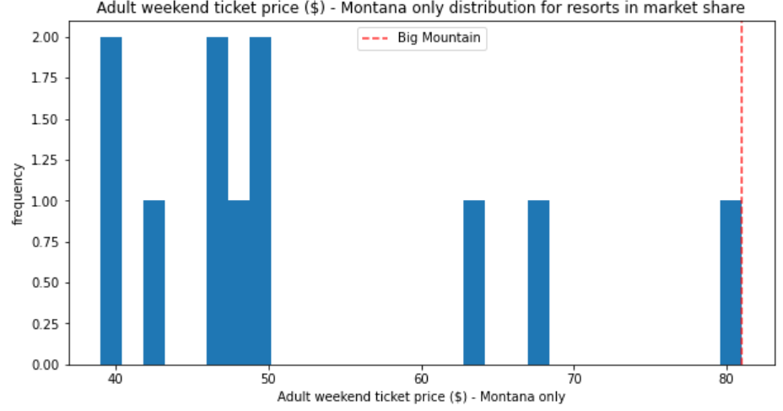
Modeling results and analysis
Big Mountain Resort In Market Context
Ticket price:
The ticket price of Big Mountain is a little bit higher amongst all resorts for price.
The ticket price of Big Mountain sits the highest amongst all resorts in Montana.

Slide 8
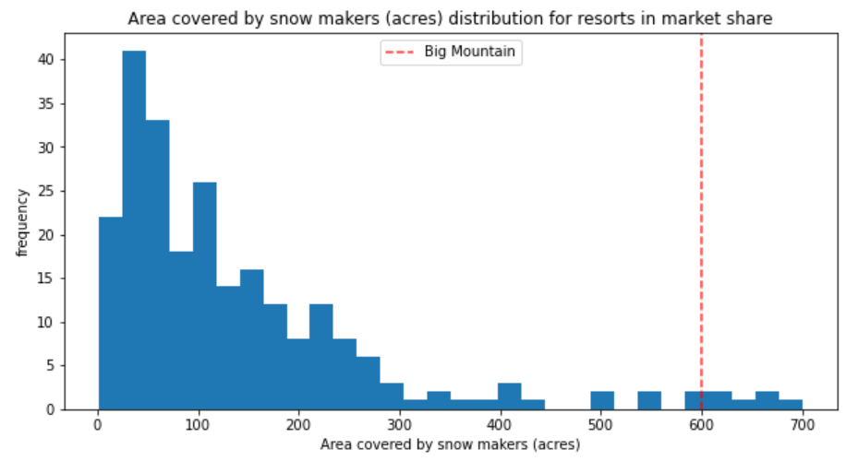
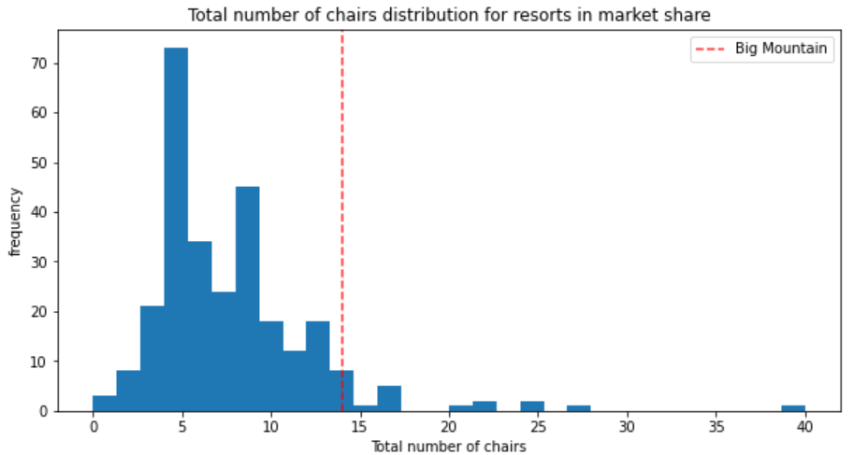
Modeling results and analysis
Snow making area:
Total number of chairs:
Big Mountain is very high up the league table of snow making area.
Big Mountain has amongst the highest number of total chairs, resorts with more appear to be outliers.

Slide 9
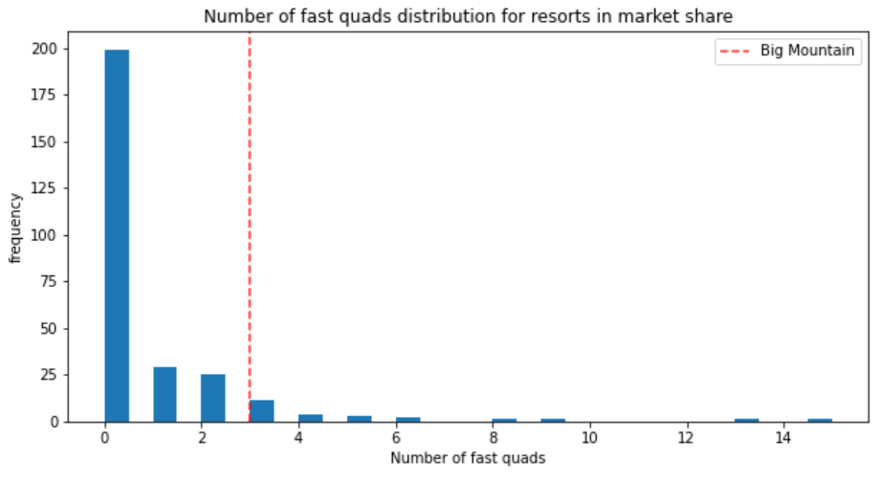
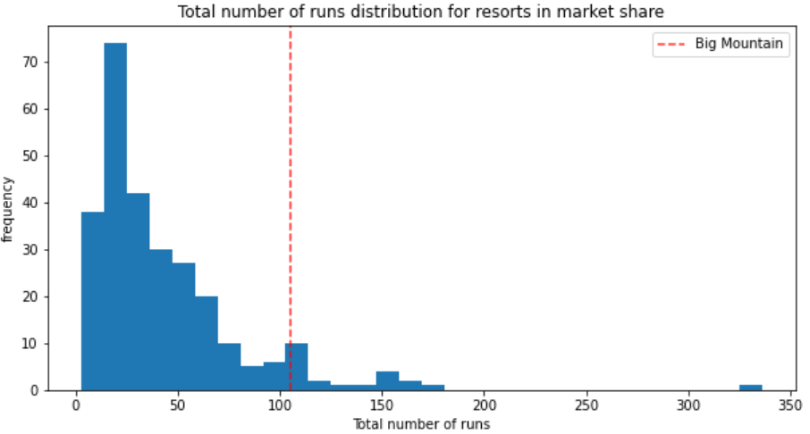
Modeling results and analysis
Fast quads:
Runs:
Most resorts have no fast quads. Big Mountain has 3, which puts it high up that league table. There are some values much higher, but they are rare.
Big Mountain compares well for the number of runs. There are some resorts with more, but not many.

Slide 10
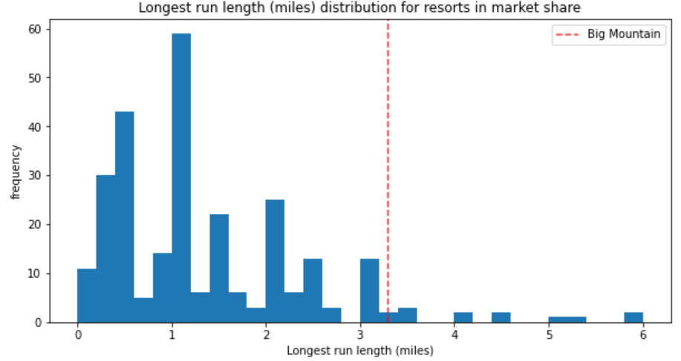
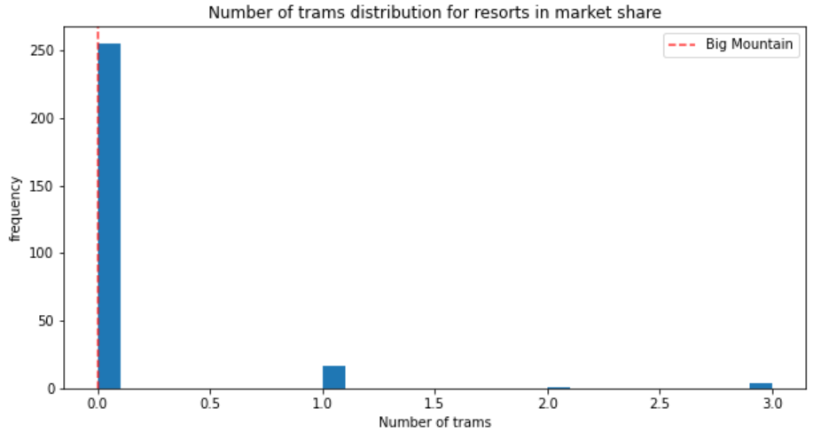
Modeling results and analysis
Longest run:
Trams:
Big Mountain has one of the longest runs. Although it is just over half the length of the longest, the longer ones are rare.
The vast majority of resorts, such as Big Mountain, have no trams.

Slide 11
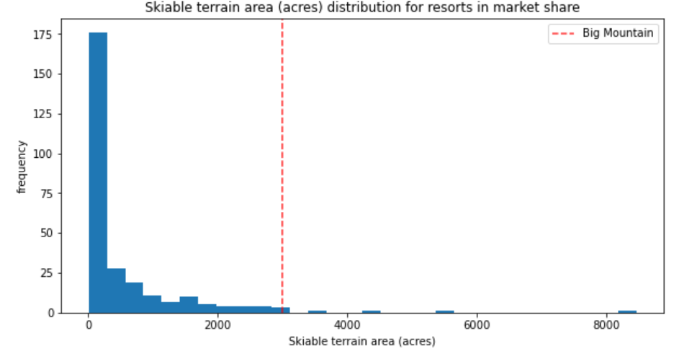
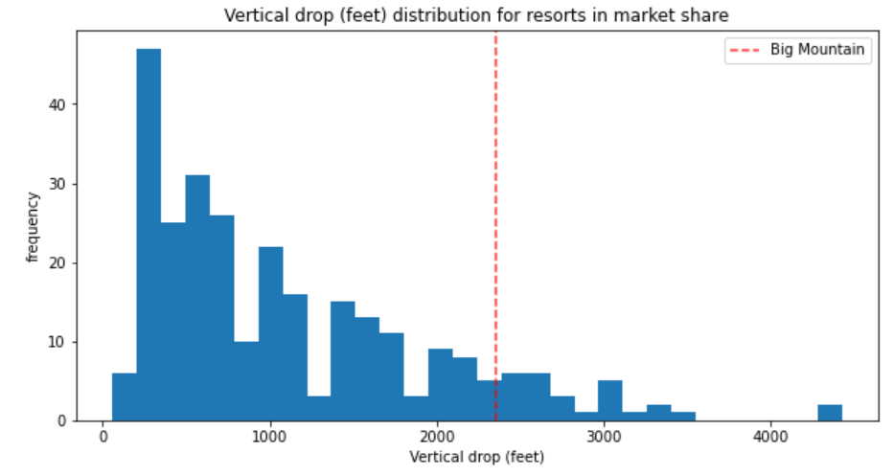
Modeling results and analysis
Skiable terrain area:
Vertical drop:
Big Mountain is amongst the resorts with the largest amount of skiable terrain.
Big Mountain is doing well for vertical drop, but there are still quite a few resorts with a greater drop.

Slide 12
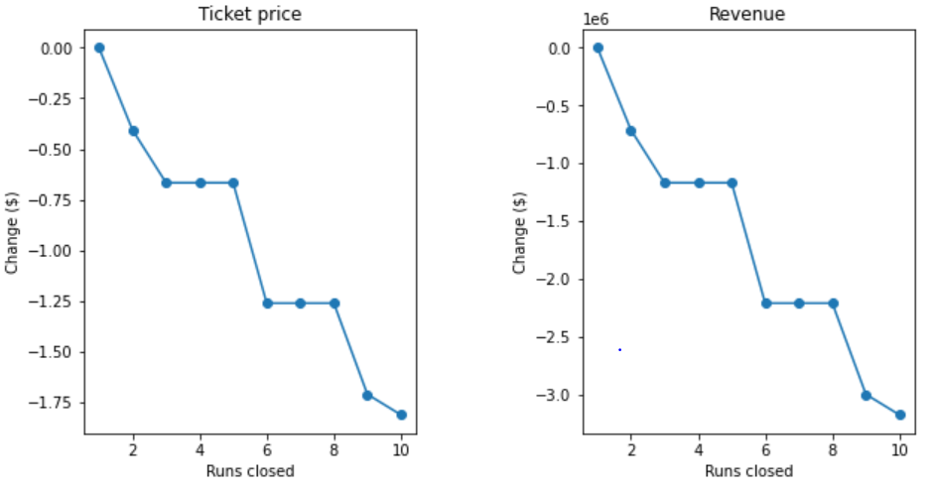
Modeling results and analysis
Ticket price and revenue vs. runs closed
Closing one run makes no difference. Closing 2 and 3 successively reduces support for ticket price and so revenue. If Big Mountain closes down 3 runs, it seems they may as well close down 4 or 5 as there's no further loss in ticket price. Increasing the closures down to 6 or more leads to a large drop.

Slide 13
Modeling results and analysis
Adding a run, increasing the vertical drop by 150 feet, and installing an additional chair lift - increase support for ticket price by $1.99.
Adding a run and 2 acres of snow making, increasing the vertical drop by 150 feet, and installing an additional chair lift - makes no difference.
Increasing the longest run by 0.2 miles and guaranteeing its snow coverage by adding 4 acres of snow making capability - makes no difference.

Slide 14
Summary and conclusion
Based on the advantages Big Mountain has and the original price was much lower than the predicted one, there is room for a price increment.
If Big Mountain adds a run, increases the vertical drop by 150 feet, and installs an additional chairlift, this scenario will be supported from the model for ticket price increased by $ 1.99, which lead to the final price of $82.99. Over the season, this could be expected to amount to $3474638.
This model indicates closing one run makes no difference. Closing 2 and 3 successively reduces support for ticket prices, and so does the revenue. If Big Mountain closes down three runs, it seems they may as well close down 4 or 5, as there's no further loss in the ticket price. If increasing the closures down to 6 or more leads to a significant drop in the ticket price and the revenue – so Big Mountain could close 4-5 runs to save the operational and maintenance cost.

